Slide 1
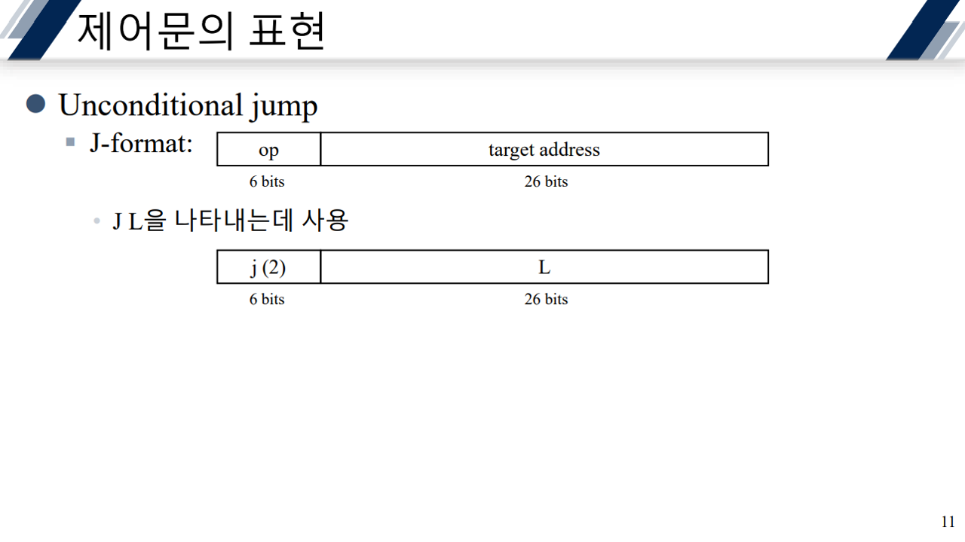
*MIPS = 32bit CPU
instruction system
➔ 1 instruction = 1 line = 32bit = 4byte
Jump without any condition
*J-format
Just a specific way of using 32bit separately
Add, sub → r-format
Addi → I-format
00010
If L(2) ➔ 00000000000000000000000010
= jump to this 32bit address (pc front 4bit + upper 26bit + 00) → why? 00 is fixed, and usually jumps to near instruction, so it’s not much differ from now address(PC). front 4bit of PC is enoughly big for fill up the left of 4bit (32-26-2(“00”)).
*L
If has 2 different meaning between unconditional and conditional
<conditional> [relative]
The length(16,26bit) is not important. It’s useless
You just have to know that it is a ❤️count❤️ of skipping instruction(s)
<unconditional> [absolute]
26bits refers to some part of the address of target instruction// [PC front 4 bit] + 26bits + 00[fixed]

Slide 2
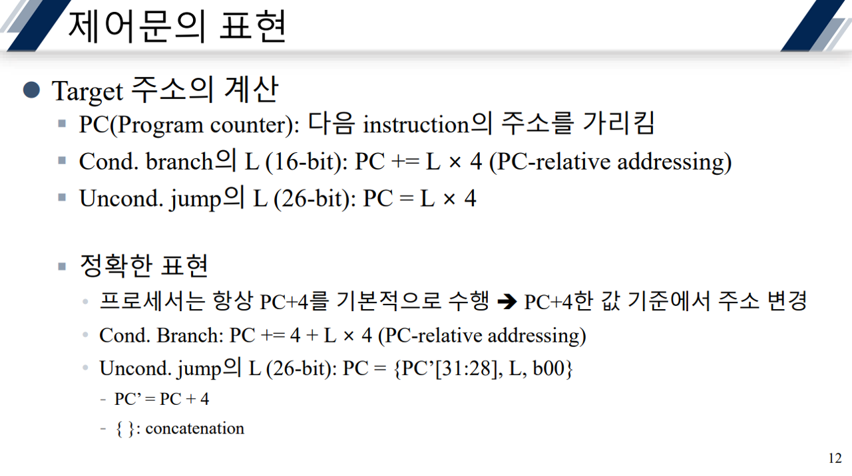
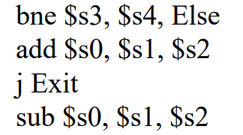
The way to calculating target address
Indicating the address of next instruction
➔ Move considering now
Jump if condition is true
➔ Move to exactly other
Jump without any condition
Because it’s 32bit CPU, and memory address uses count of byte
1 instruction = “1 line = 4byte” ➔ if want to jump 1 line, it is same as moving 4bytes
L = Count of skipping instruction
Binary or bit
Line 1
Front 4bit of PC
Line 2
Like chain. It occurs continuously
Line 3
Line 4

